Slide 1
Introducing Lists

Slide 2

I Also Have Another Cat Named
Weasley…

Slide 3
Learning Objectives
Explain what a Python list is and why they’re used
Be able to create a list and populate it with elements
Add, remove, and modify items in a list
Apply a number of methods to manipulate or summarise lists

Slide 4
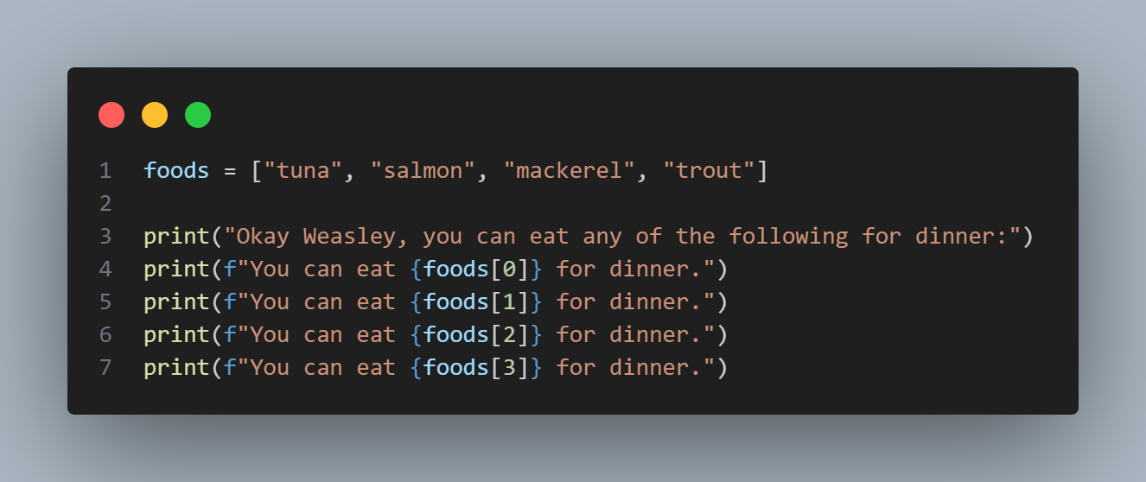
Notes:
Take a look at this code… What would happen if I ran this?
foods = ["tuna", "salmon", "mackerel", "trout"]
print("Okay Weasley, you can eat any of the following for dinner:")
print(f"You can eat {foods[0]} for dinner.")
print(f"You can eat {foods[1]} for dinner.")
print(f"You can eat {foods[2]} for dinner.")
print(f"You can eat {foods[3]} for dinner.")
Let’s break down the components of this piece of code…..

Slide 5
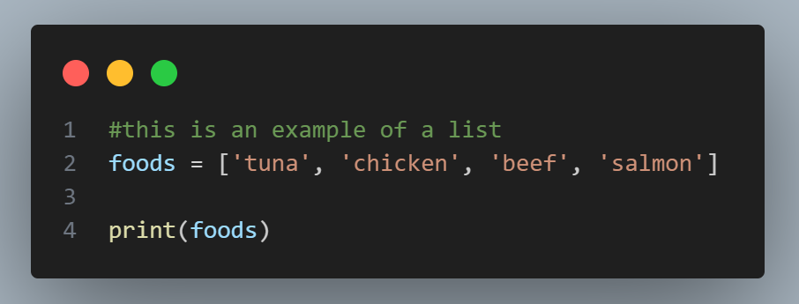
What is a List?
A list is one way of storing multiple pieces of data in a single variable
A list is a collection of items in a particular order.
You can make a list that includes the letters of the alphabet, the digits from 0–9, or the names of all the people in your family (for me, my cats)
In Python, square brackets [ ] indicate a list, and individual elements in the list are separated by commas. Here is an example of a simple list:
Notes:
#this is an example of a list
foods = ['tuna', 'chicken', 'beef', 'salmon']
print(foods)
What is a list?
Show example of the list. Notice the brackets, this is how you tell Python that this is a list.

Slide 6
Notes:
foods = ["tuna", "salmon", "mackerel", "trout"]
print("Okay Weasley, you can eat any of the following for dinner:")
print(f"You can eat {foods[0]} for dinner.")
print(f"You can eat {foods[1]} for dinner.")
print(f"You can eat {foods[2]} for dinner.")
print(f"You can eat {foods[3]} for dinner.")
Going back to our original code, you can see where our list is located and it is encased in square brackets. But what does the rest of the code do?

Slide 7
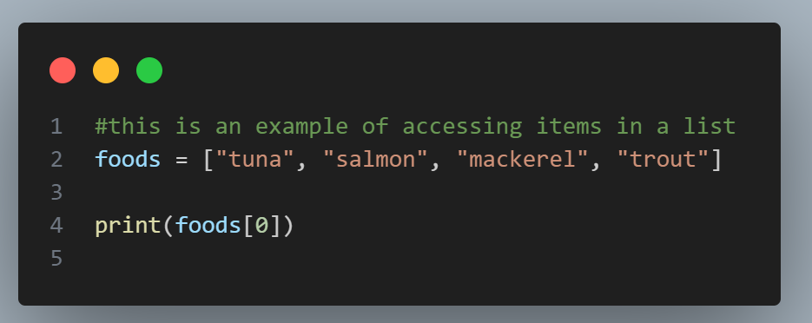
Accessing Elements Within a List
Lists are ordered collections, so you can access any element in a list by telling Python the position, or index, of the item desired.
To access an element in a list, write the name of the list followed by the index of the item enclosed in square brackets, known as the index number.
Remember, the index positions start at 0, not 1* You can use negative numbers to access items in a list from the opposite direction - This means that [-1] will always retrieve the last item, even if you don’t know the length of the list.
*This is an important point which will pop up often in the future
Notes:
#this is an example of accessing items in a list
foods = ["tuna", "salmon", "mackerel", "trout"]
print(foods[0])
Try changing the number in the brackets, you will see how you can access different elements within the list!

Slide 8
Notes:
Going back to our original code, you can see how lines 3-5 accesses different elements within my list of foods!
But what if I ran out of one of the items in the list? Is there a way I can modify or delete an item? What about add any additional items?

Slide 9
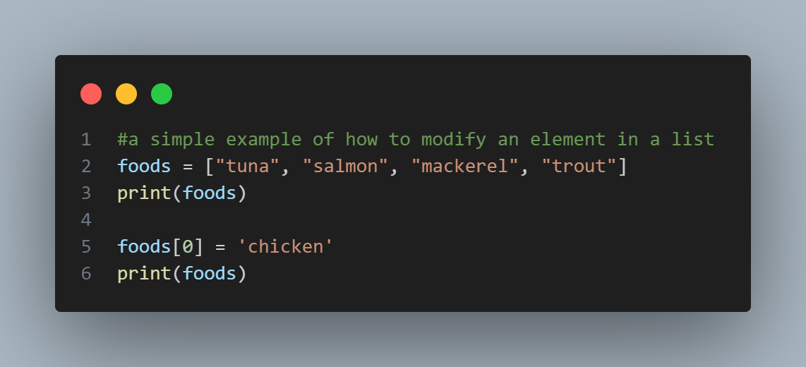
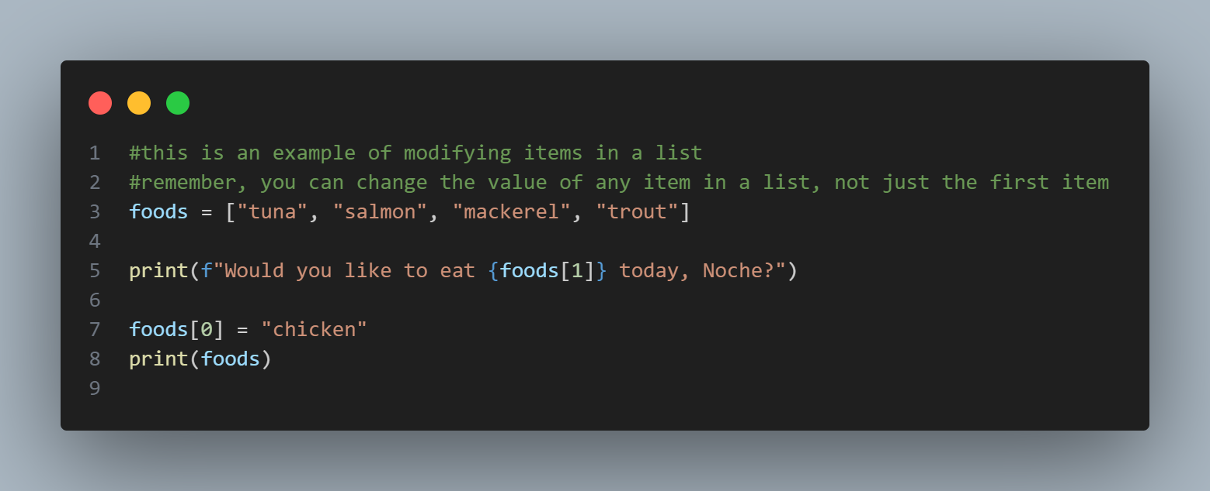
Changing/Modifying Elements in a List
The syntax for modifying an element is similar to the syntax for accessing an element in a list. To change an element, use the name of the list followed by the index of the element you want to change, and then provide the new value you want that item to have.
Notes:
#a simple example of how to modify an element in a list
foods = ["tuna", "salmon", "mackerel", "trout"]
print(foods)
foods[0] = 'chicken'
print(foods)
#this is an example of modifying items in a list
#remember, you can change the value of any item in a list, not just the first item
foods = ["tuna", "salmon", "mackerel", "trout"]
print(f"Would you like to eat {foods[1]} today, Noche?")
foods[0] = "chicken"
print(foods)

Slide 10
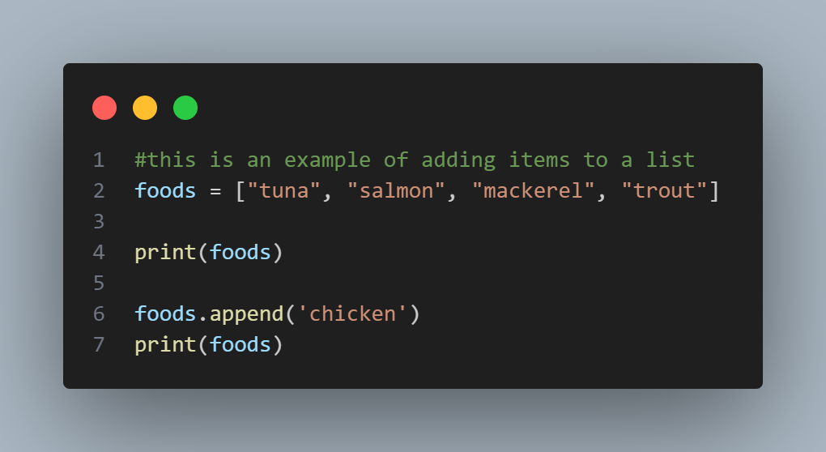
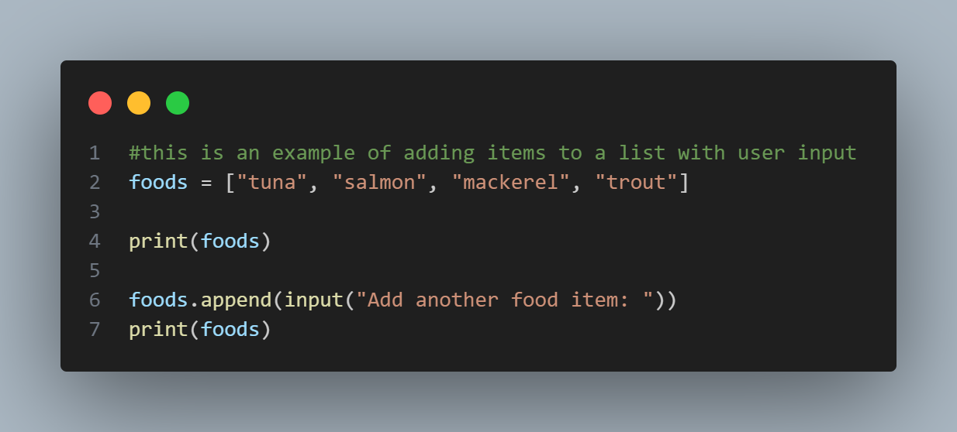
Adding Elements to a List
Use .append() to add an item to the end of the list, it will not affect any of the other items
Notes:
#this is an example of adding items to a list
foods = ["tuna", "salmon", "mackerel", "trout"]
print(foods)
foods.append('chicken')
print(foods)
#this is an example of adding items to a list with user input
foods = ["tuna", "salmon", "mackerel", "trout"]
print(foods)
foods.append(input("Add another food item: "))
print(foods)

Slide 11
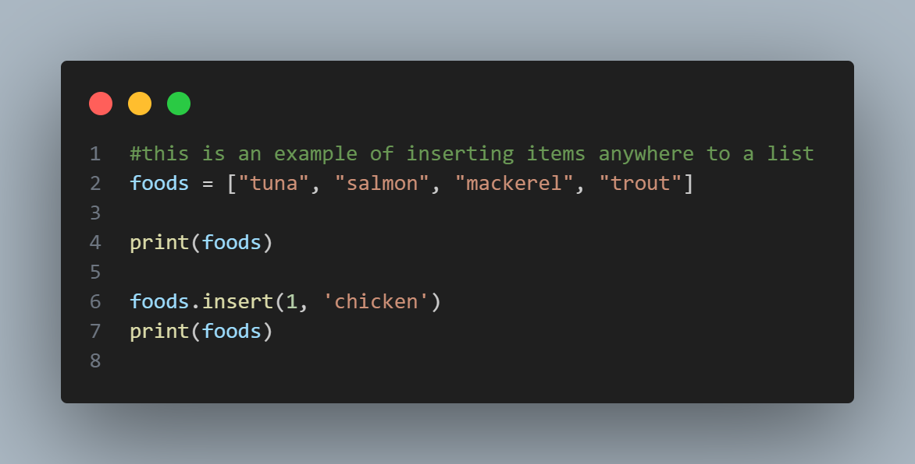
Inserting Elements into a List
Append always adds to the end, but it easy to insert elements anywhere on a list, you just need to know what index position you want the new element to be.
Notes:
#this is an example of inserting items anywhere to a list
foods = ["tuna", "salmon", "mackerel", "trout"]
print(foods)
foods.insert(1, 'chicken')
print(foods)

Slide 12
Removing an Item in a List
There are a few ways to be able to remove an item from a list. You can use:
pop() - remove the last item
del - remove an item by index number
remove() - remove an item by value

Slide 13
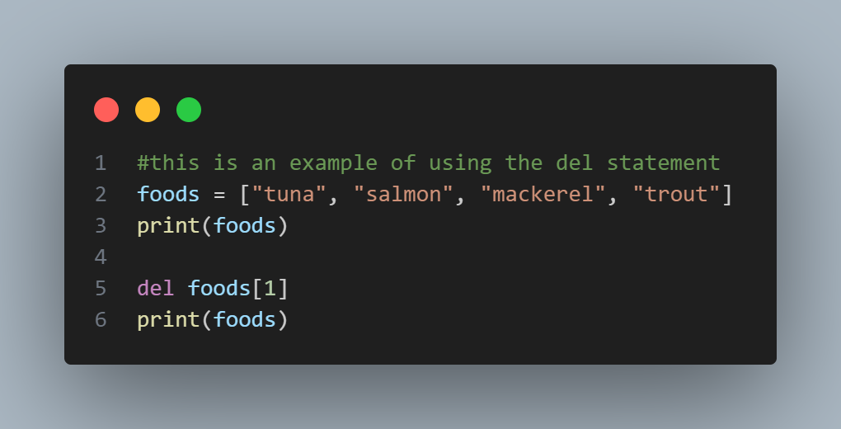
Del statements
If you know the position of the element you wish to delete from a list, you can use the del statement. Remember, after you use the del statement you can no longer access that element in the list for the rest of the code!
Notes:
#this is an example of using the del statement
foods = ["tuna", "salmon", "mackerel", "trout"]
print(foods)
del foods[1]
print(foods)

Slide 14
The pop() Method
You can also use the pop() method to remove an item from a list. This will remove the last item in your list, but also lets you continue working with that item after removing it.
Think of this like a stack of books - you take (or pop) one book off the stack and start reading it, when done you may put it somewhere else, or discard it.
By default the pop() method removes the last item, or an item from any position if you know the index number of the element to remove.
Notes:
#this is an example of using the pop() method
foods = ["tuna", "salmon", "mackerel", "trout"]
print(foods)
popped_food = foods.pop() #storing the food that was popped into the variable popped_food
print(foods)
print(popped_food) #notice here you can still access the element that was popped!
#this is an example of using the pop() method
#This will show how to remove an item from a specified position
foods = ["tuna", "salmon", "mackerel", "trout"]
print(foods)
popped_food = foods.pop(1)
print(f"Sorry Noche, we do not have {popped_food} anymore!")
print(foods)

Slide 15
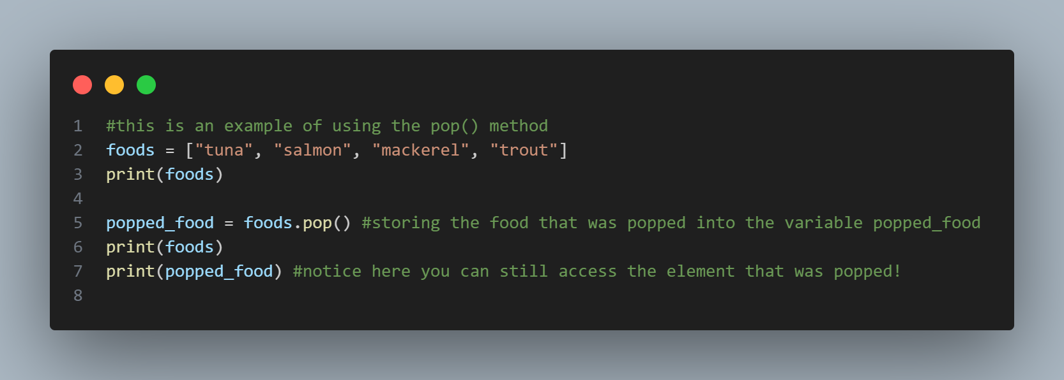
The pop() Method
Notes:
#this is an example of using the pop() method
foods = ["tuna", "salmon", "mackerel", "trout"]
print(foods)
popped_food = foods.pop() #storing the food that was popped into the variable popped_food
print(foods)
print(popped_food) #notice here you can still access the element that was popped!

Slide 16
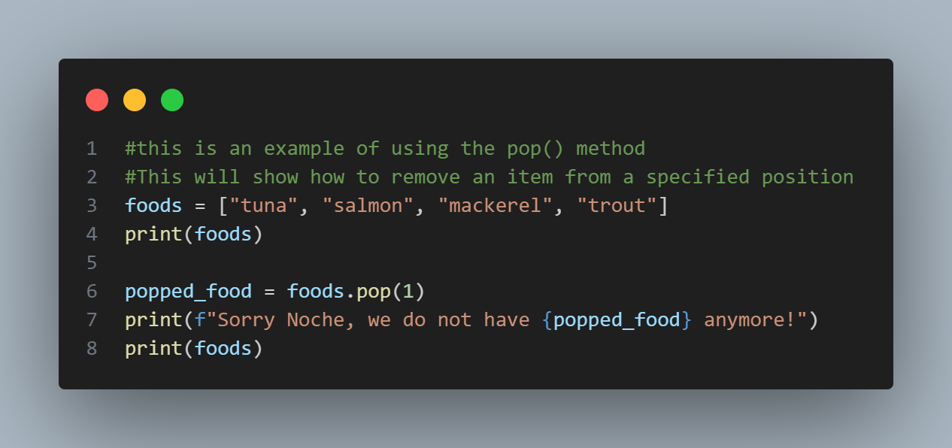
The pop() Method
Notes:
#this is an example of using the pop() method
#This will show how to remove an item from a specified position
foods = ["tuna", "salmon", "mackerel", "trout"]
print(foods)
popped_food = foods.pop(1)
print(f"Sorry Noche, we do not have {popped_food} anymore!")
print(foods)

Slide 17
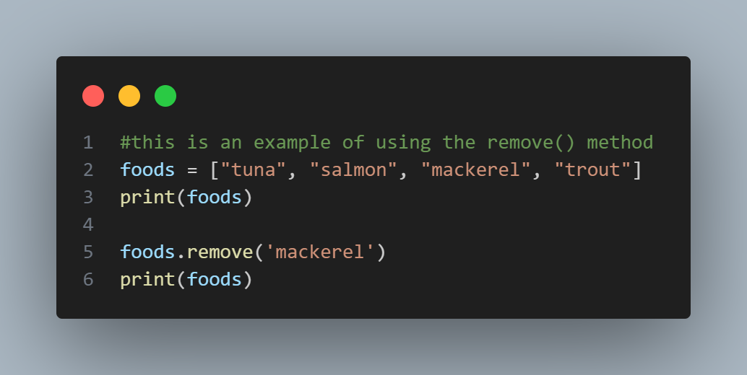
The remove() Method
If you do not know the position of the element you wish to remove from a list, only the value, then use the remove() method.
Notes:
#this is an example of using the remove() method
foods = ["tuna", "salmon", "mackerel", "trout"]
print(foods)
foods.remove('mackerel')
print(foods)

Slide 18
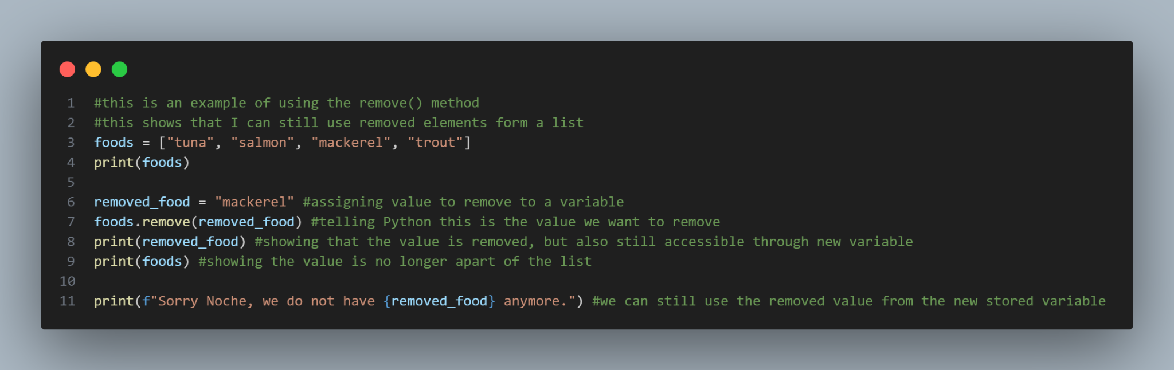
remove() Method
Notes:
#this is an example of using the remove() method
#this shows that I can still use removed elements form a list
foods = ["tuna", "salmon", "mackerel", "trout"]
print(foods)
removed_food = "mackerel" #assigning value to remove to a variable
foods.remove(removed_food) #telling Python this is the value we want to remove
print(removed_food) #showing that the value is removed, but also still accessible through new variable
print(foods) #showing the value is no longer apart of the list
print(f"Sorry Noche, we do not have {removed_food} anymore.") #we can still use the removed value from the new stored variable

Slide 19

We have learned how to modify, delete, and update a list… But can I organize a list?

Slide 20
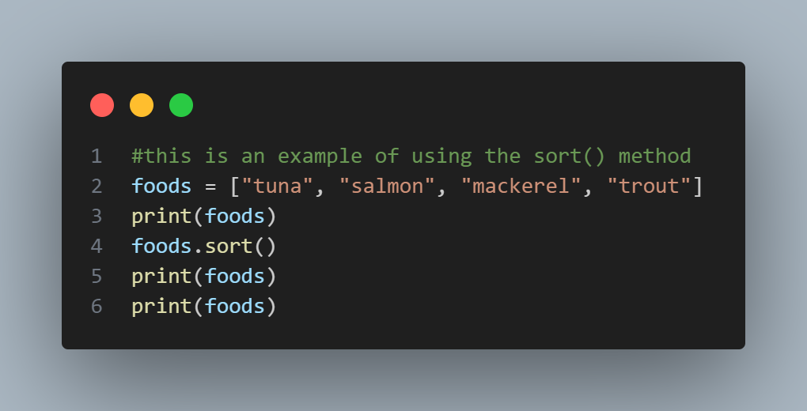
Sort a list permanently with the sort() Method
Notes:
#this is an example of using the sort() method
foods = ["tuna", "salmon", "mackerel", "trout"]
foods.sort()
print(foods)
#this is an example of using the sort() method
foods = ["tuna", "salmon", "mackerel", "trout"]
print(foods)
foods.sort()
print(foods)
print(foods)

Slide 21
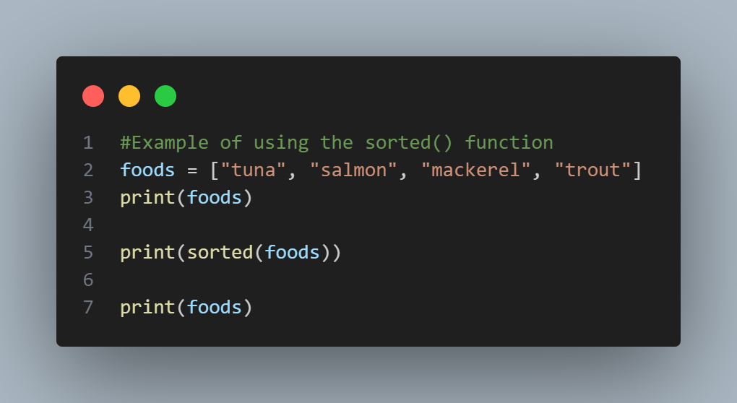
Sort a list temporarily with the sorted() function
Notes:
#Example of using the sorted() function
foods = ["tuna", "salmon", "mackerel", "trout"]
print(foods)
print(sorted(foods))
print(foods)

Slide 22
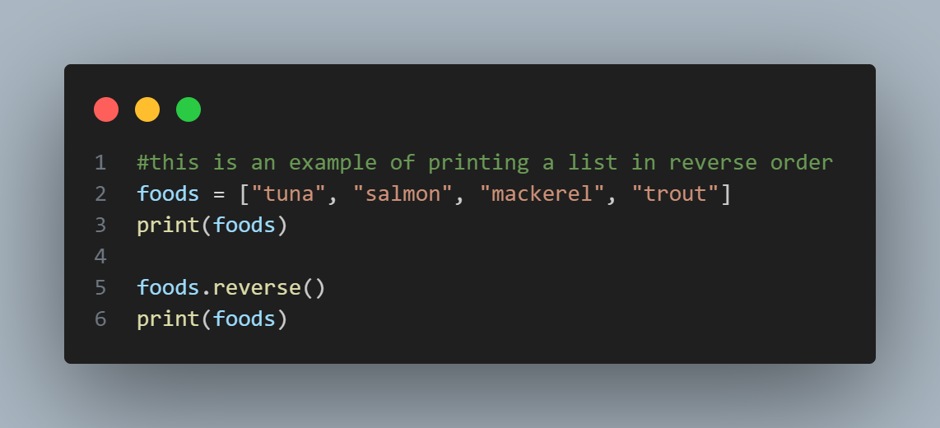
Printing a List in Reverse Order
Notes:
#this is an example of printing a list in reverse order
foods = ["tuna", "salmon", "mackerel", "trout"]
print(foods)
foods.reverse()
print(foods)

Slide 23
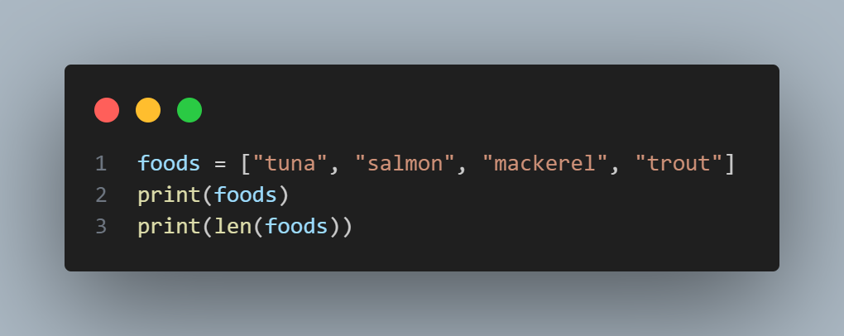
Finding the Length of a List - len()
Notes:
foods = ["tuna", "salmon", "mackerel", "trout"]
print(foods)
print(len(foods))
#You can also do this in the terminal!!

Slide 24
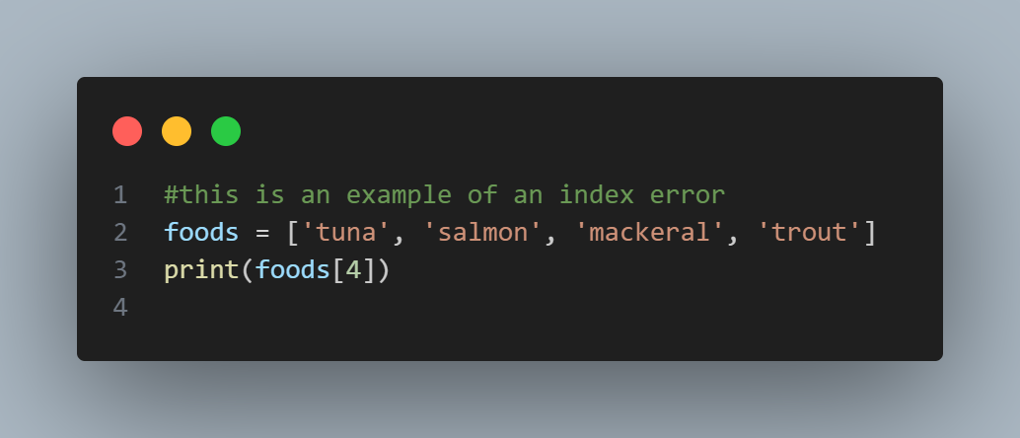
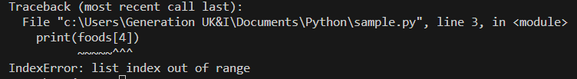
Avoiding Index Errors in a List…

Slide 25
Notes:
Take a look at this code… What would happen if I ran this? Hopefully you can tell me now!
foods = ["tuna", "salmon", "mackerel", "trout"]
print("Okay Weasley, you can eat any of the following for dinner:")
print(f"You can eat {foods[0]} for dinner.")
print(f"You can eat {foods[1]} for dinner.")
print(f"You can eat {foods[2]} for dinner.")
print(f"You can eat {foods[3]} for dinner.")
Try modifying my code, show off your skills! Make it your own.

Slide 26
Next up… Exercise 2: Introducing Lists!`

